Slide 1

Coherent Consumer Behavioral Analysis
COHERENT
CUSTOMER BEHAVIOR ANALYSIS
Group – 4
Team Members: Krishan Kumar, Yash Sharma,
Divyansh Ganotra, Harsh Bhalla,
Shubhrant Shah, Animesh Srivastava,
Akash Roy, Sahib Nijhavan
Team Mentor: Mr. Sourab Reddy

Slide 2

Problem Statement
In FMCG, leveraging customer analytics to glean insights from vast datasets is a pressing challenge.
Our project focuses on seamlessly integrating analytical techniques for marketing decisions, aiming to foster sustainable business growth through informed strategies using customer’s purchase data.
We identify segmentations, interpret behavior, and make precise predictions for adaptive strategies.

Slide 3
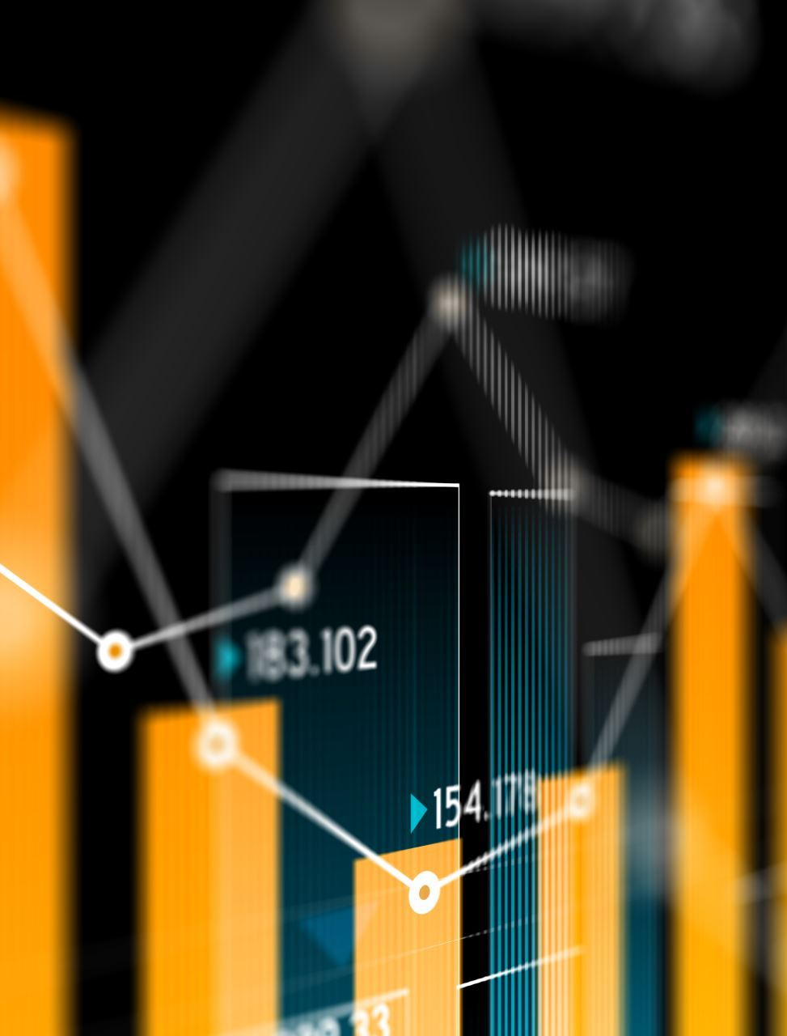
Introduction
The problem at hand involves leveraging Customer Analytics through a multi-step approach.
First, the challenge lies in effectively segmenting customers using cluster analysis and dimensionality reduction, employing Python and packages like NumPy, SciPy, and scikit-learn.
The second phase demands applying descriptive statistics to interpret segmented customers' behavior, forming hypotheses for subsequent modeling.
The third stage involves elasticity modeling for purchase probability exploring various elasticities through advanced regression techniques.
Milestone 1:
Customer Analysis
Milestone 2:
Exploratory data analysis for Purchase Analysis
Milestone 3:
Purchase Analysis

Slide 4
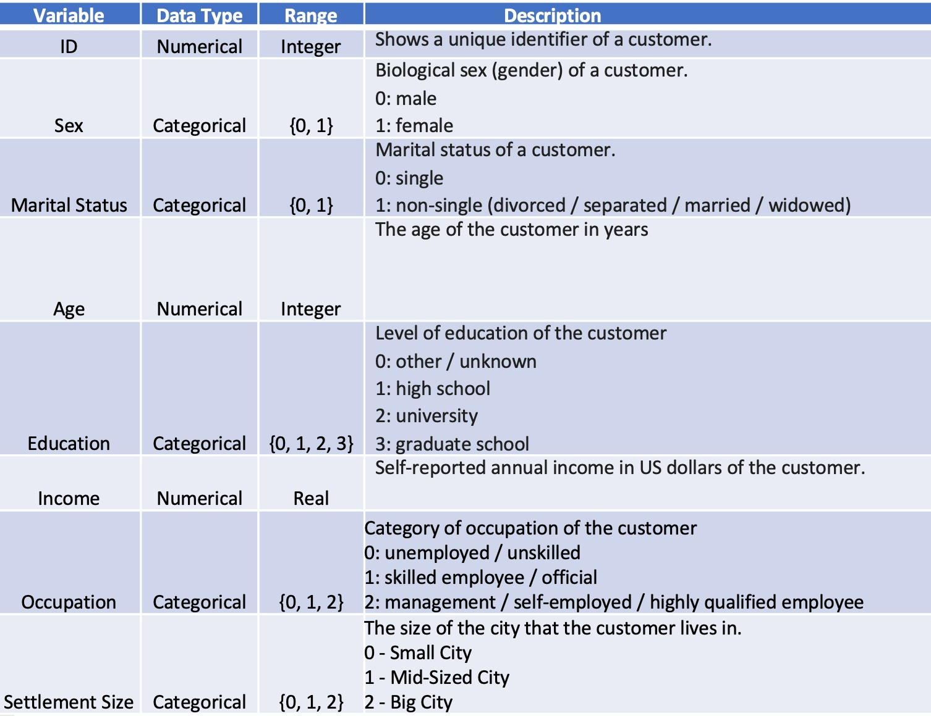
Segmentation Data Dictionary

Slide 5
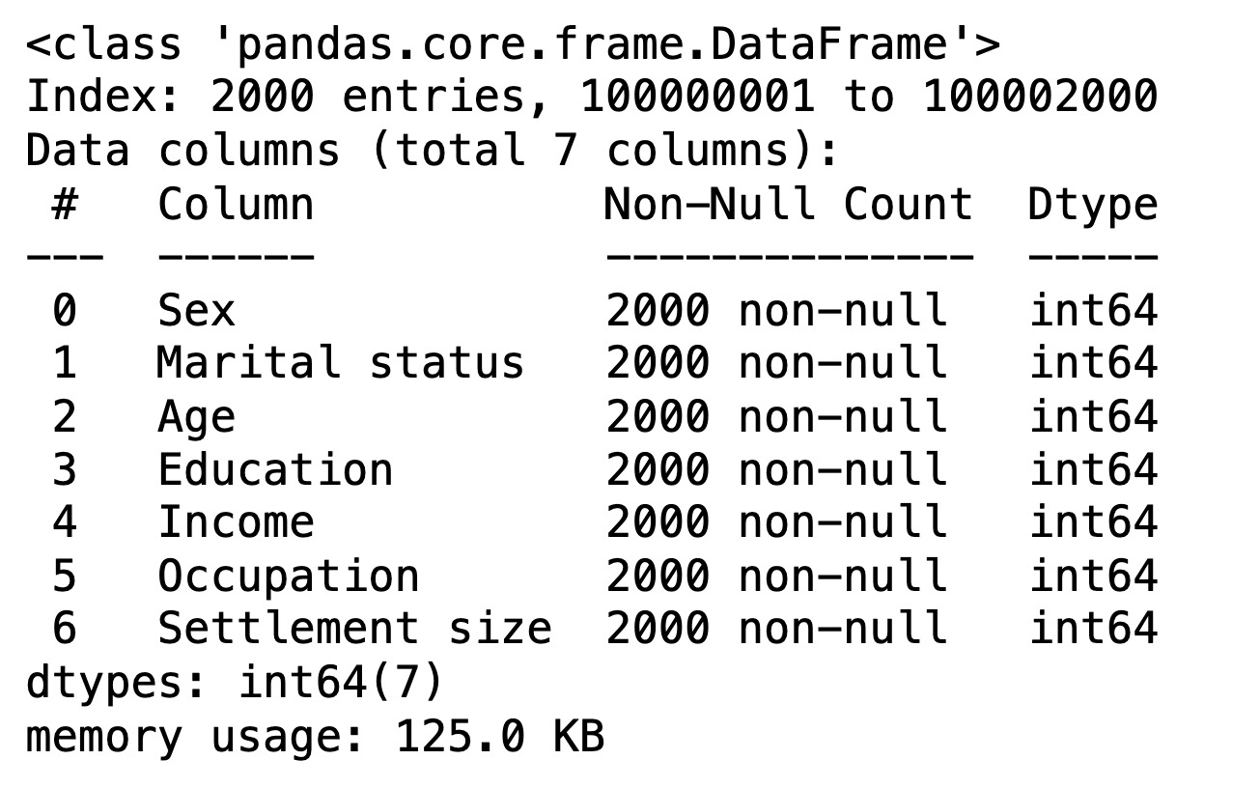
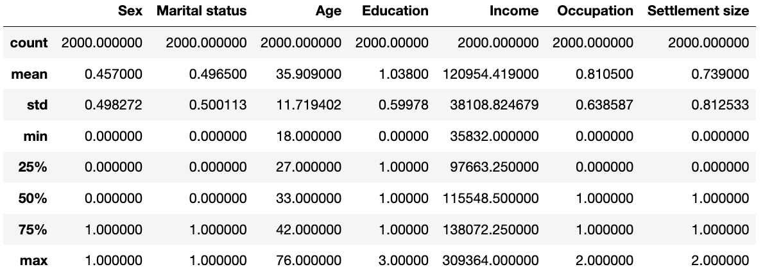
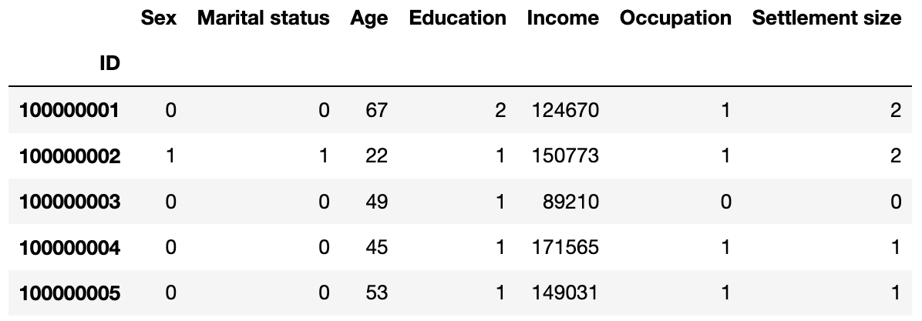
Milestone 1: Customer Analysis
Segmentation Dataset
Contains information on the purchasing behavior of 2,000 individuals.
Data collected from loyalty cards used at checkout in a physical 'FMCG' store.
Preprocessed data with no missing values.
Dataset
Dataset Description

Slide 6
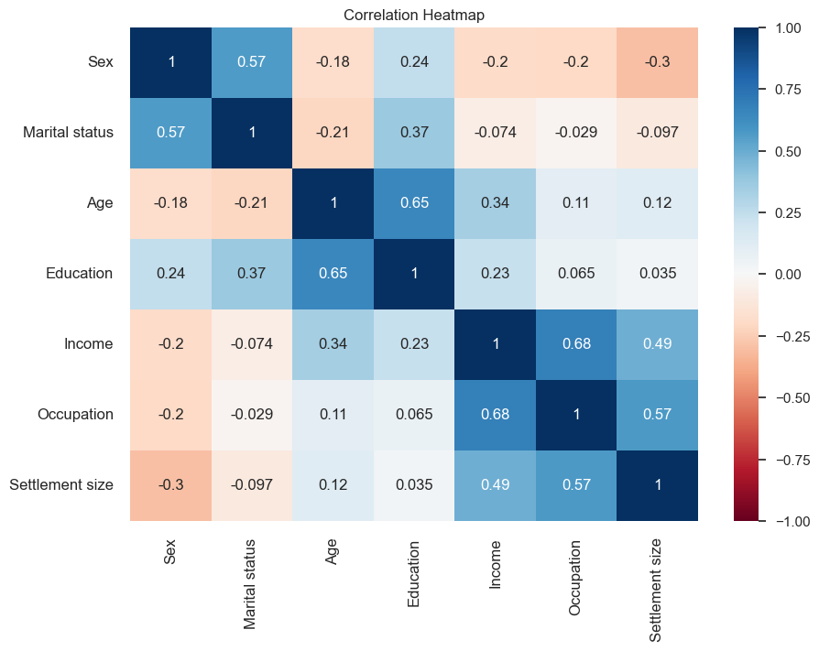
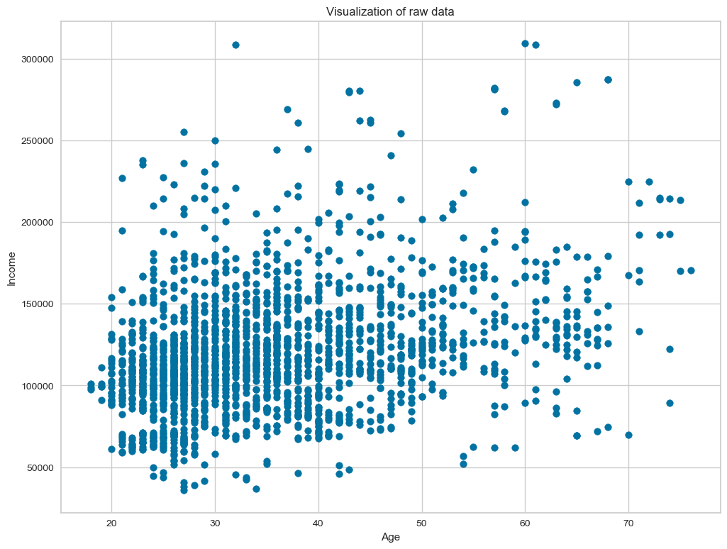
Correlation and Visualization

Slide 7
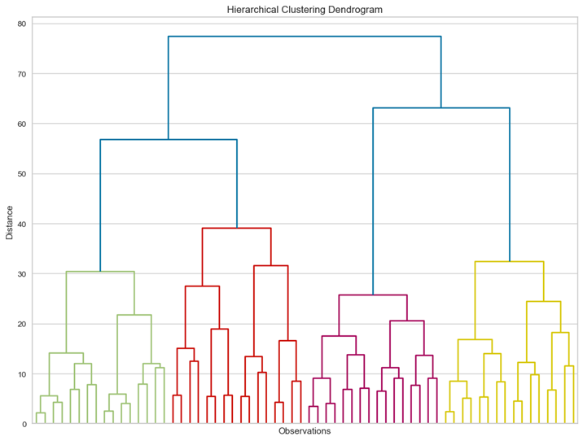
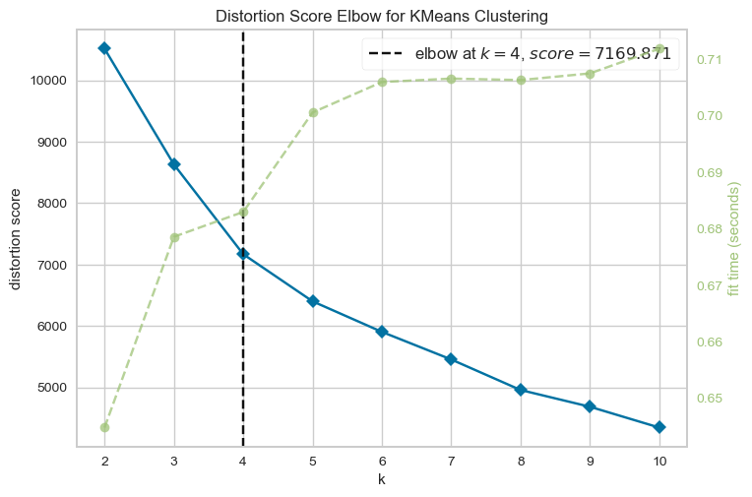
Clustering
K-means Clustering:
Choose the number of clusters
Specify cluster seeds
Calculate the centroid (geometrical center)
Repeat until the centroids stop changing
Hierarchical Clustering
K-Means Clustering

Slide 8
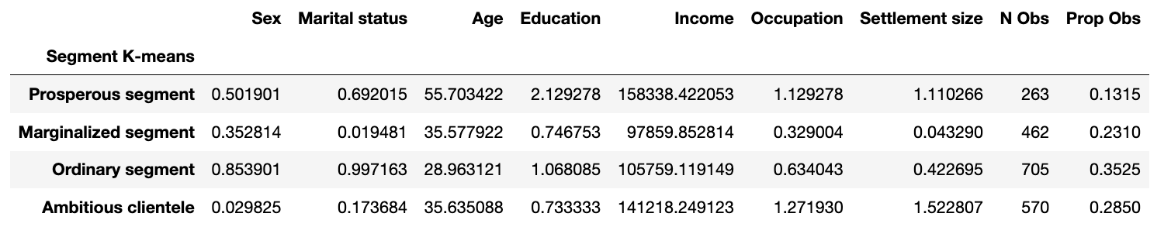
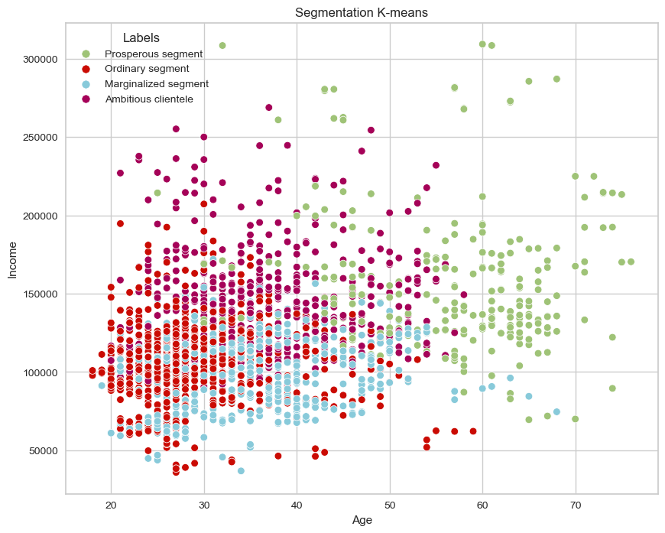
Results
For segment 0, sex ratio 50% for males and 50% for females. 69% are married. Their avg age is 56. Education level is highest compared to other segments. Annual income is also highest compared to other segments. We labelled this segment as Prosperous.
For segment 1, 35% are females and almost all are single. Their avg age is 36. Their education level is low on average as compared to other segments. Annual income is lowest compared to other segments. And they live in small cities. We labelled this segment them Marginalized.
For segment 2, 85% are females and all are in relationships. Their avg age in 29. They have medium level of education, average income and middle management jobs. They seem equally distributed between small, mid-sized and big cities. They are avg in most parameters, so we labelled this segment as Ordinary.
For segment 3, it comprises almost entirely of men, less than 20% of whom are in relationships. Avg age is 36. They relatively have low Education paired with high level of annual income. Most of this segment lives in big or middle-sized cities.

Slide 9
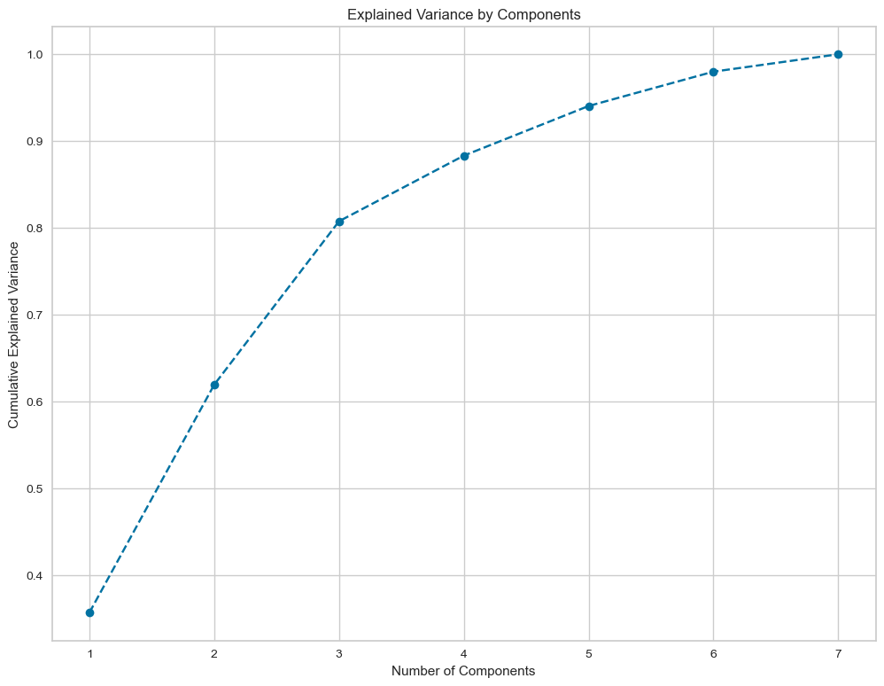
Principal Component Analysis (PCA)
The goal of PCA is to find the best possible subspace which explain most of the variance. Most commonly it is used to reduce the dimensionality (number of features) of a problem.
The attribute shows how much variance is explained by each of the seven individual components.
Utilization of PCA:
Identifies a subset of components capturing variance within the data.
Seven components selected, organized in descending order of significance.
Variance Explained by Components:
First component explains 36% of variance.
Second component explains 26% of variance.
Third component explains 19% of variance.
Fourth to Seventh components explain remaining variance.
Cumulative Variance Explained:
Plotting cumulative variance explained by total number of components.
Selecting subset of components to retain around 80% of explained variance.

Slide 10
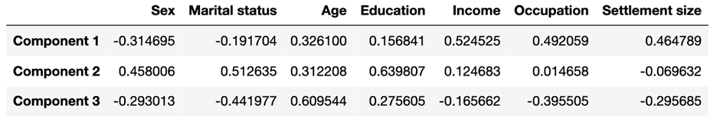
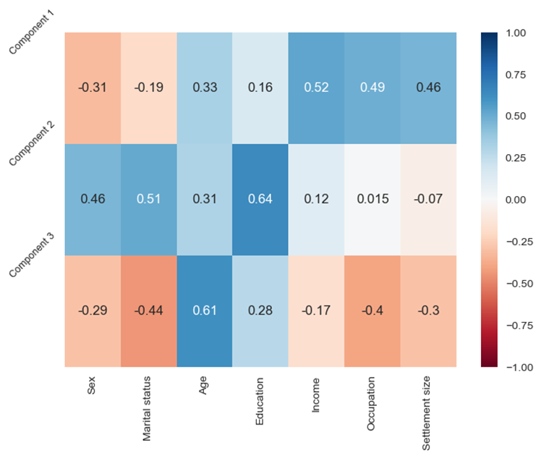
PCA Results
For Component 1 we see positive correlation between Age, Occupation, Settlement size. These are related to career of a person, so this component shows the Career focus of the individual.
For Component 2 we see positive correlation between Sex, Marital status and Education. These are related to education and lifestyle of the individual.
For Component 3 we see positive correlation for Age and negative correlation for Marital status and Occupation. This indicates the experience a person has, no matter if work experience or life experience.

Slide 11
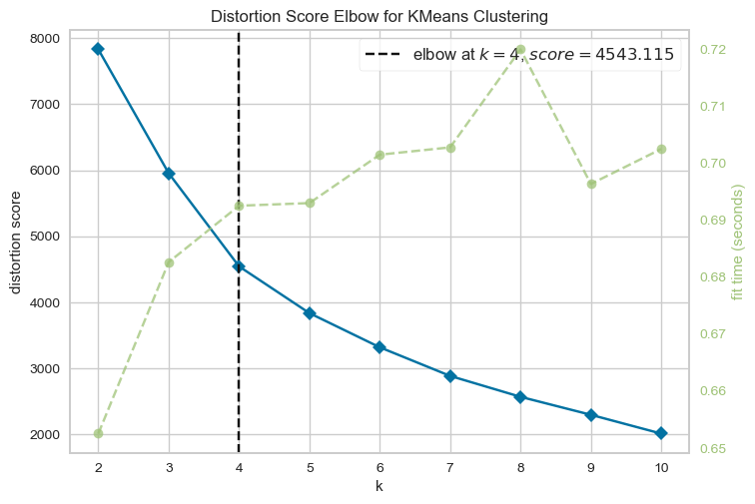
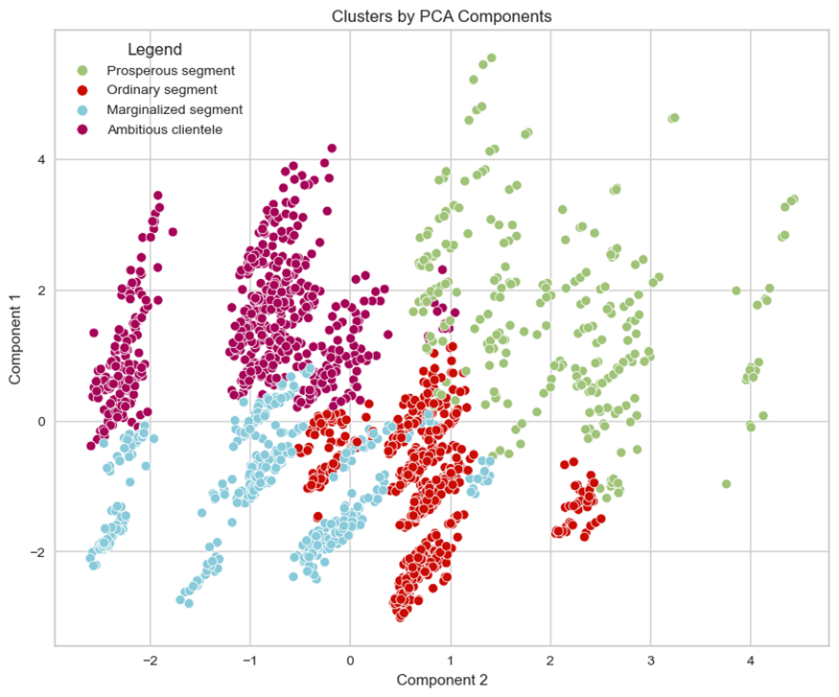
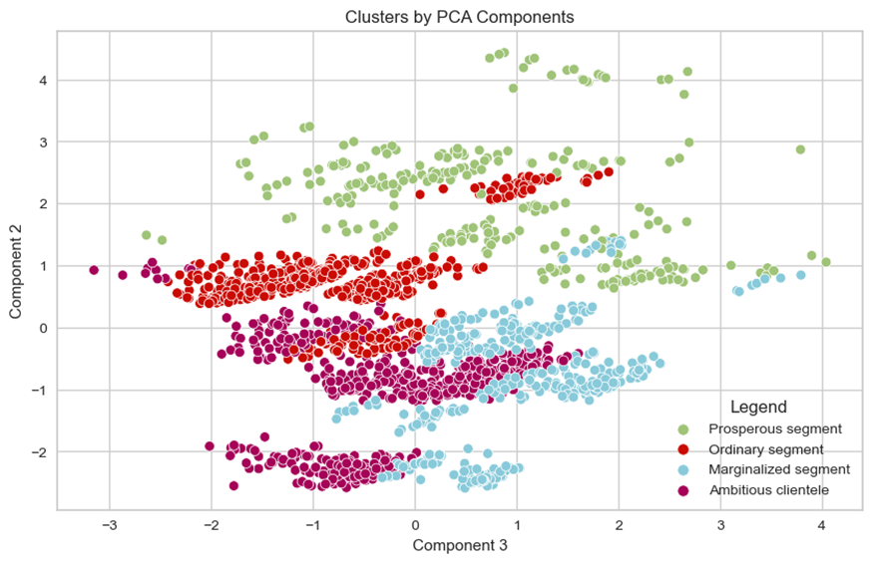
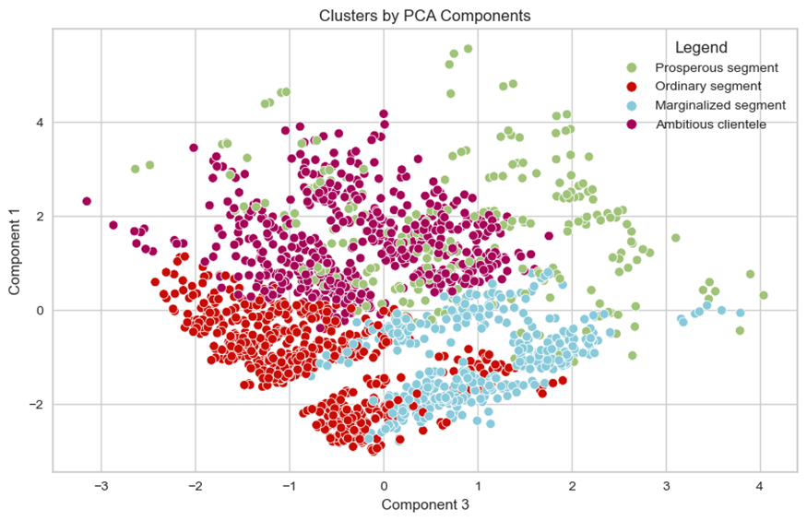
K Means Clustering with PCA Results
Reduce Dimensionality with PCA
Perform K-means with PCA scores as features
Visualize and interpret clusters
Component 1 Career
Component 2 Education Lifestyle
Component 3 Experience

Slide 12
Milestone 2: Purchase Analysis
Purchase Dataset
Records purchases of chocolate candy bars by 500 individuals over 2 years.
Data collected through loyalty cards used at checkout.
Preprocessed data with no missing values.
Exploratory Data Analysis
Steps for EDA:
Data Preview
Number of Rows and Columns
Data Information
Columns in the Dataset
Data Description
Null Values
Null Value Treatment
Correlation using Heatmap
Univariate Analysis for Numerical Columns with Visualization
Univariate Analysis for Categorical Columns with Visualization

Slide 13
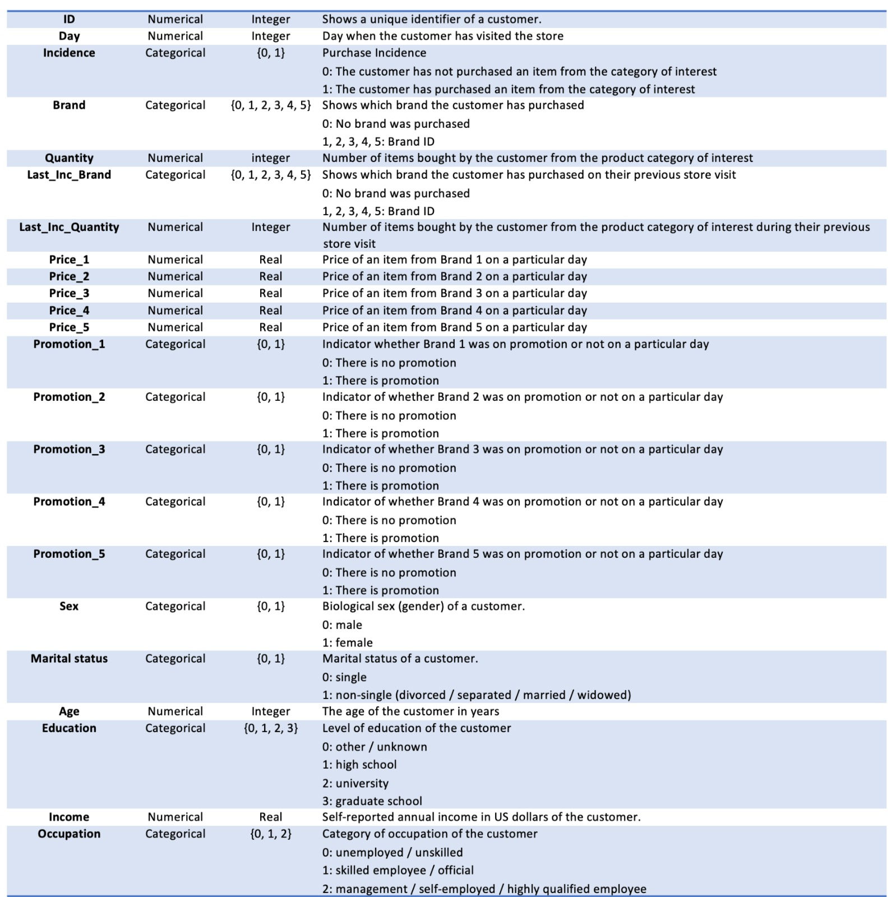
Purchase Data Dictionary

Slide 14
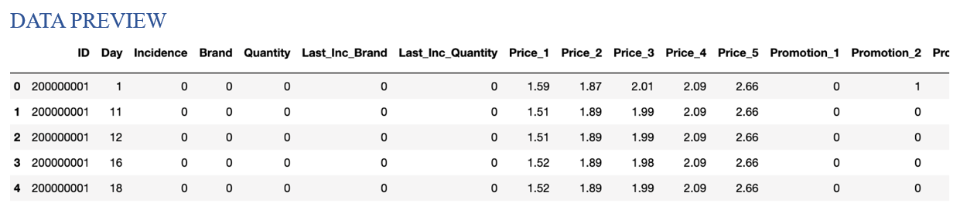
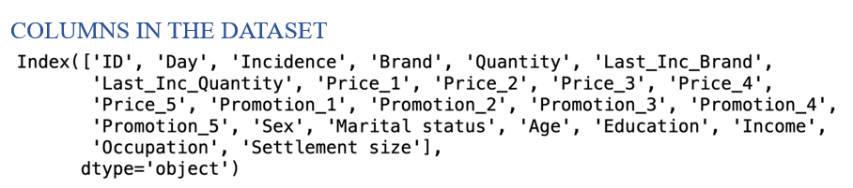
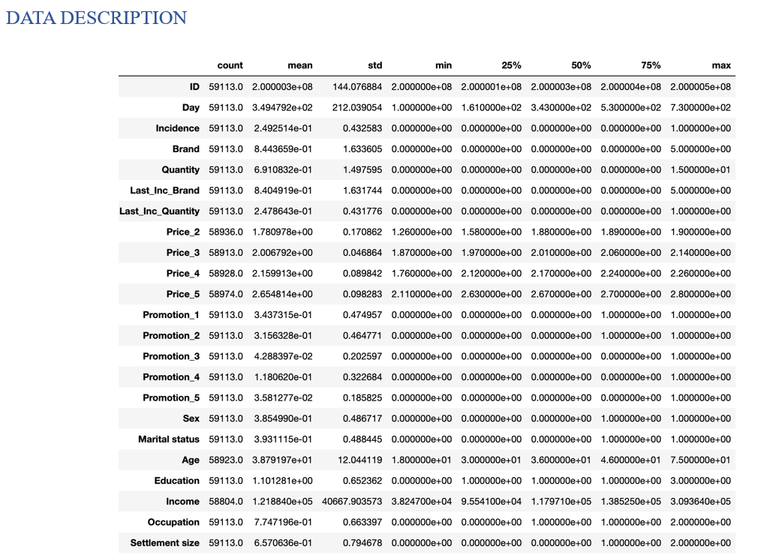
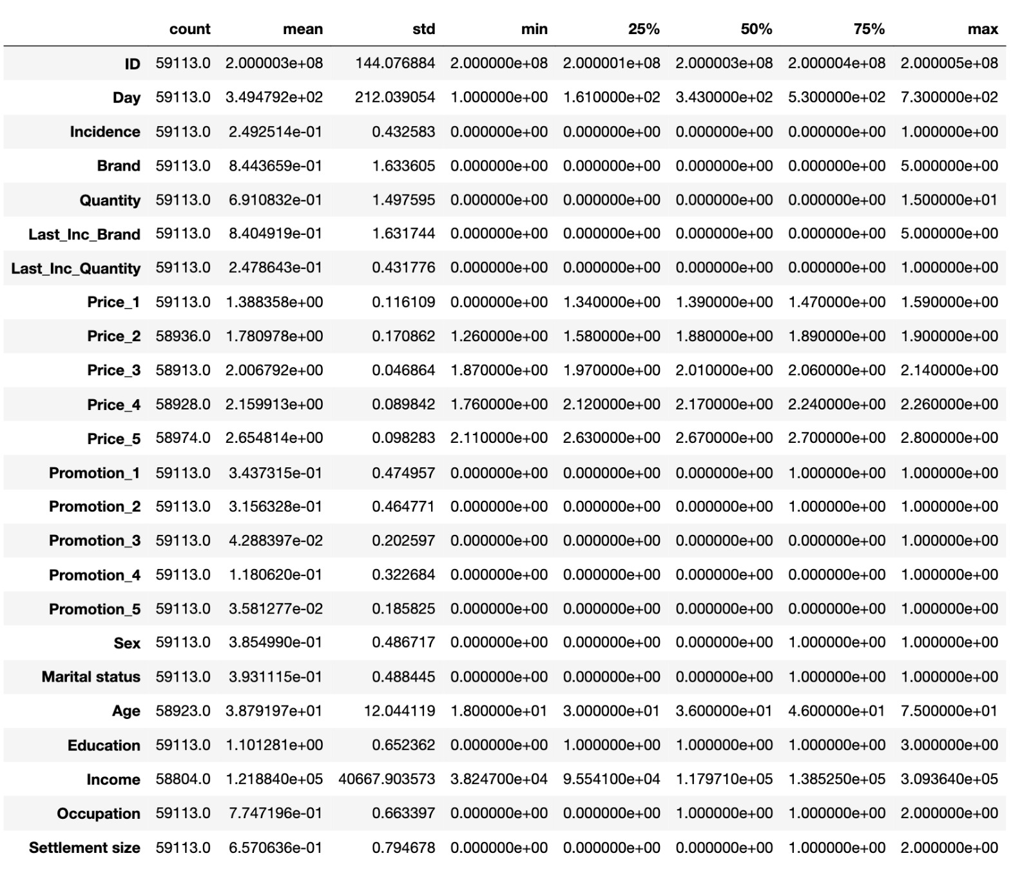
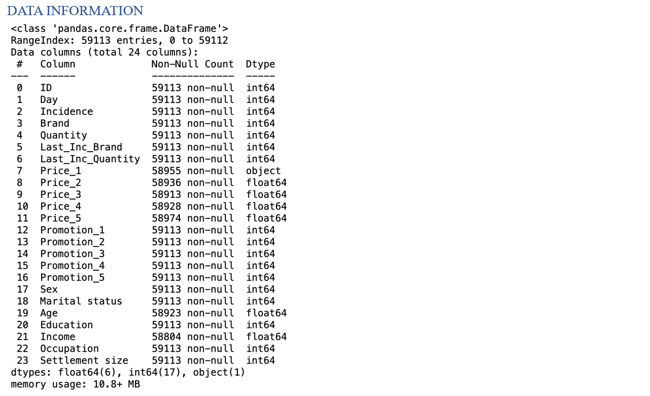
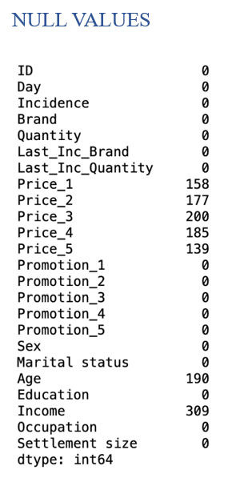
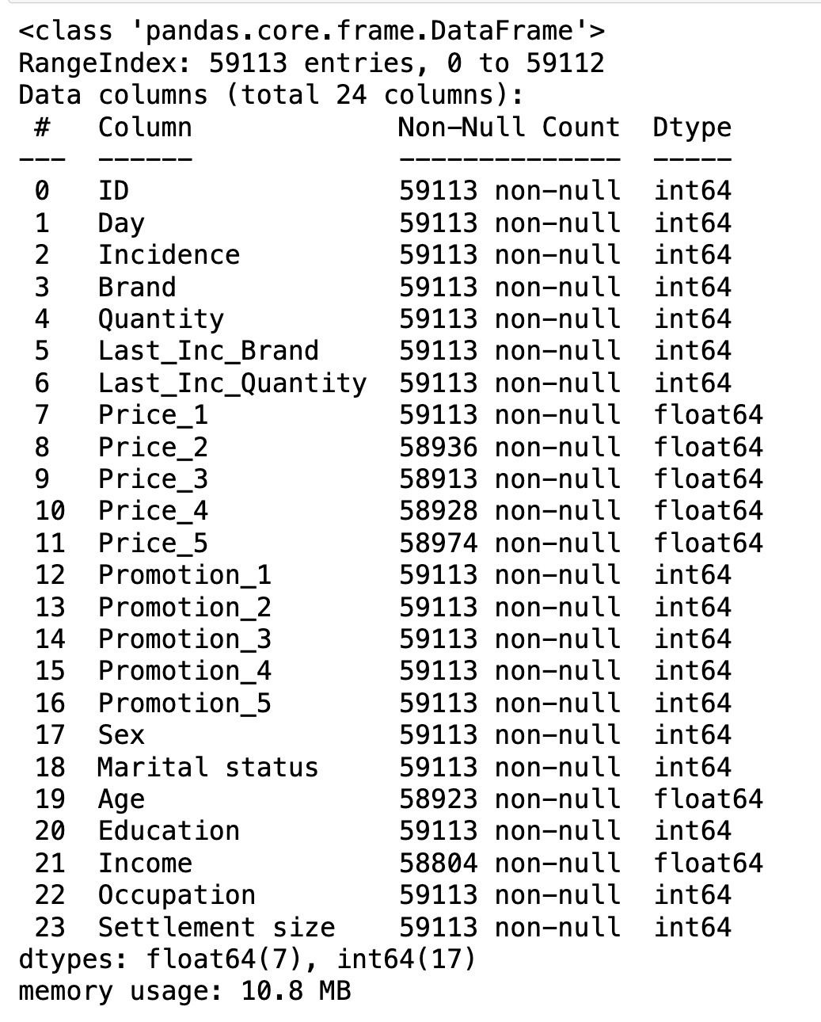
Exploratory Data Analysis

Slide 15
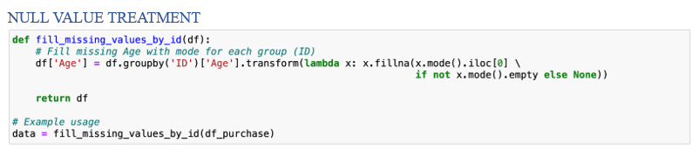
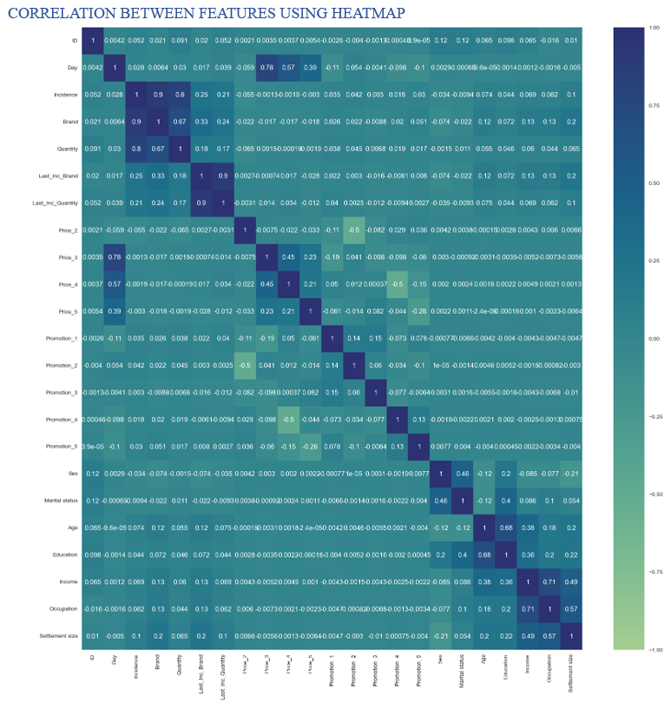
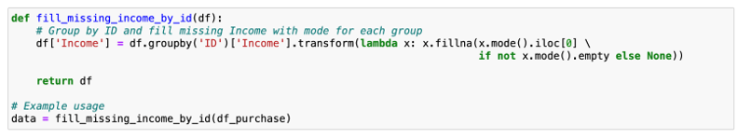
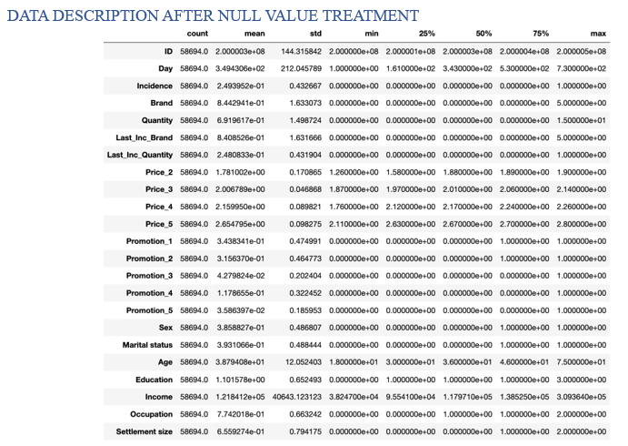
Correlation Heat Map

Slide 16
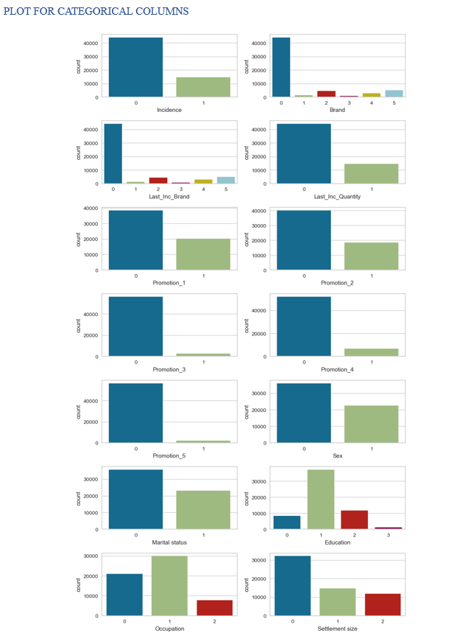
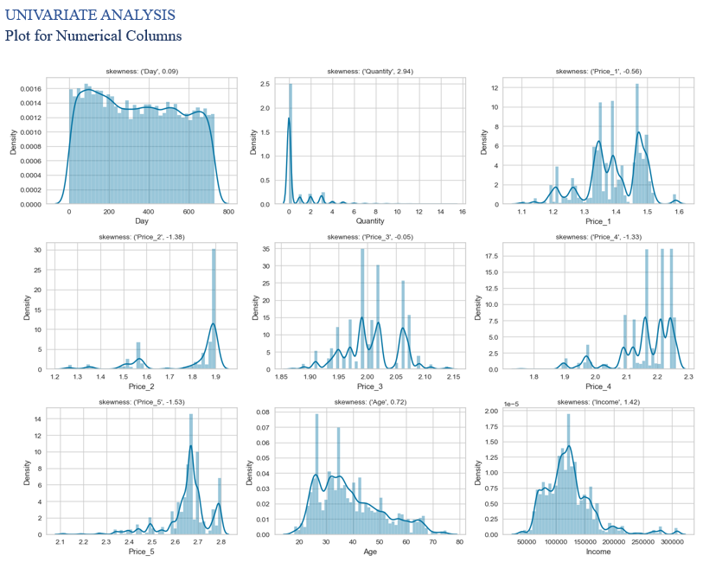
Univariate Analysis for Numerical and Categorical Columns

Slide 17
Fundamental Marketing Framework
STP Framework: STP is a fundamental marketing framework. STP framework lays out the process of exploring potential customers and understanding them. It can be applied to all areas of business and marketing activities.
Segmentation: The process of dividing a population of customers into groups that share similar characteristics.
Observations within the same group would have comparable purchasing behavior. Observations within the same group would respond similarly to different marketing activities.
Targeting: The process of evaluating potential profits from each segment and deciding which segments to focus on. Targeting is generally considered in ‘advertising’ territory. Selecting ways to promote your products. You can target one segment on TV and another online.
Positioning: What product characteristics do the customers from a certain segment need? Shows how a product should be presented to the customers and through what channels.
Customers: The clients of our business are individuals rather than organizations (B2C). The data we used came from Fast-moving consumer goods company (FMCG). The advantage of B2C model in terms of data science is that we have much more data points.

Slide 18
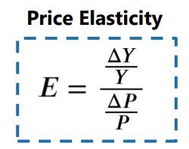
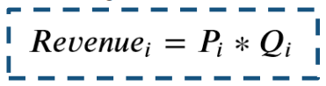
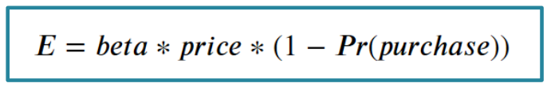
Price Elasticity: It measures how a variable of interest (purchase behavior) changes when the price changes.
Y: economic variable of interest (number of units sold),
P: price
Supply and Demand: The cheaper the product the higher the demand.
Q: quantity
P: price
We can use Price Elasticity concept to find the point at which price times quantity is
optimal.
Price Elasticity of Purchase Probability: It quantifies the change in probability of purchase of a product with a given change in its price.

Slide 19
Purchase Analysis Overview
Descriptive and Predictive Analysis:
Exploration of purchase behavior including models for purchase incidence.
Data Preprocessing:
Checking for missing values: No missing values found.
Data segmentation: Loading pickled objects for segmentation of purchase dataset.
Standardization: Standardizing the purchase data using standard scaler.
PCA: Applying PCA on the purchase data to obtain 3 principal components.
K-means PCA: Segmenting the purchase data into four segments based on principal components using K-means clustering.

Slide 20
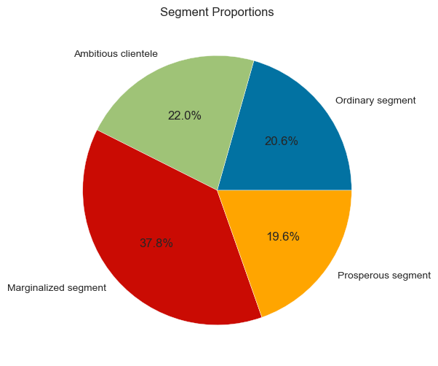
Descriptive Analysis by Segmentation
Segment proportions plotted as a pie chart to visualize distribution of store visitors across segments.
Segment Distribution:
Marginalized segment: 37.8%
Ambitious segment: 22%
Ordinary segment: 20.6%
Prosperous segment: 19.6%

Slide 21
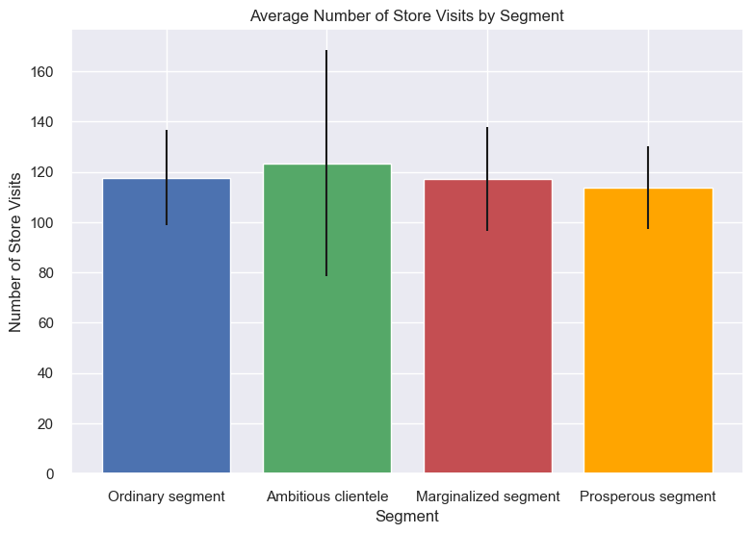
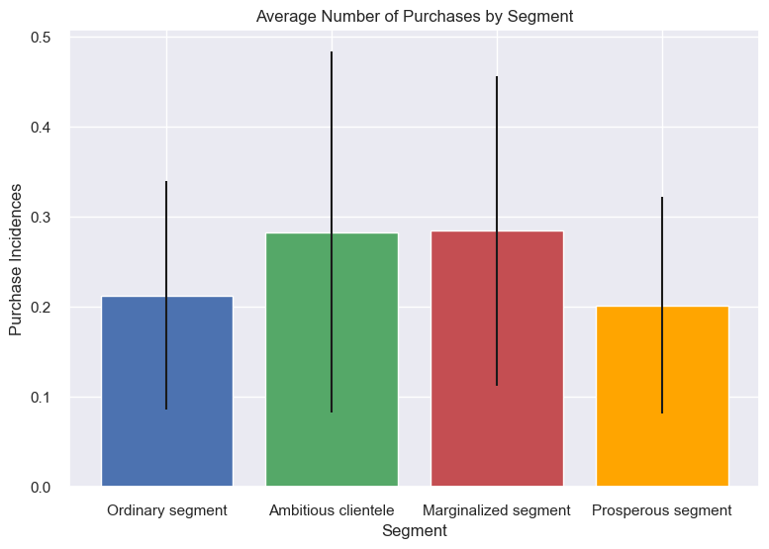
Purchase Occasion and Purchase Incidence
Plotting average number of store visits using a bar chart with standard deviation indicated.
Marginalized segment visits the store least often.
Ambitious clientele visits the store most frequently, but with high standard deviation indicating heterogeneity within the segment.
Plotting average number of purchases to understand buying frequency by segment.
Ambitious clientele buys products more often with high standard deviation.
Marginalized segment shows lowest standard deviation, indicating homogeneity.

Slide 22
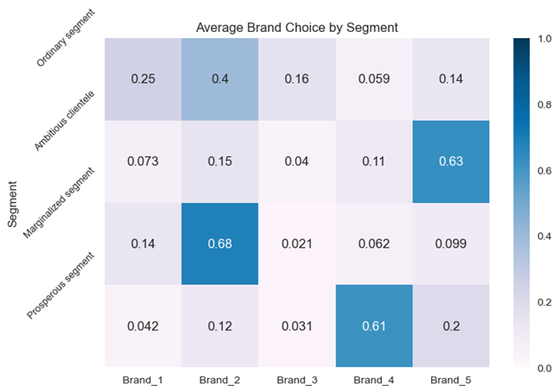
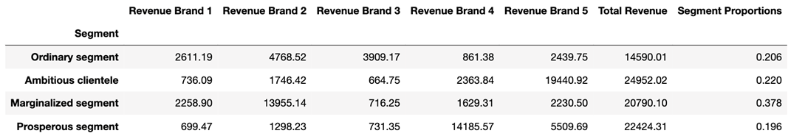
Brand Choice
Ordinary segment is most heterogeneous, they have preference for Brand 2 but weak preference for Brand 1, Brand 3, Brand 4 and Brand 5.
Ambitious clientele segment shows a strong preference for Brand 5, the most expensive brand.
Marginalized segment shows an extremely strong preference for Brand 2 to almost 70%.
Prosperous segment shows a strong preference for Brand 4.
Revenue Analysis
Ordinary segment: 20% of the total revenue.
Ambitious segment: 22% of the overall revenue.
Marginalized segment: the highest revenue of 38% of the total.
Prosperous segment: generates a total revenue of 19.6% of the overall revenue.

Slide 23
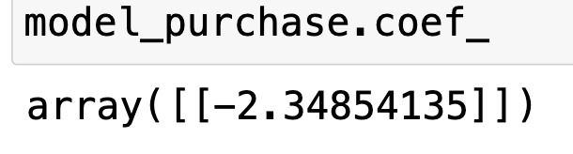
Purchase Probability Model
We use Logistic regression to predict purchase probability for each customer at each shopping trip.
Logistic regression is classification method which outputs a probability between 0 and 1.
We now try to find how Purchase probability is influenced by Price. Through model we find exact relationship between price and purchase probability.
The coefficients for price are negative, signaling that with an increase in price, the purchase probability decreases.
Price Elasticity of Purchase Probability
The price elasticity of purchase probability is % change in purchase probability in response to 1% change in price.
If the percentage change is greater than 100%, we say that the output or purchase probability is called elastic. On the other hand, for changes less than 100% it is inelastic.

Slide 24
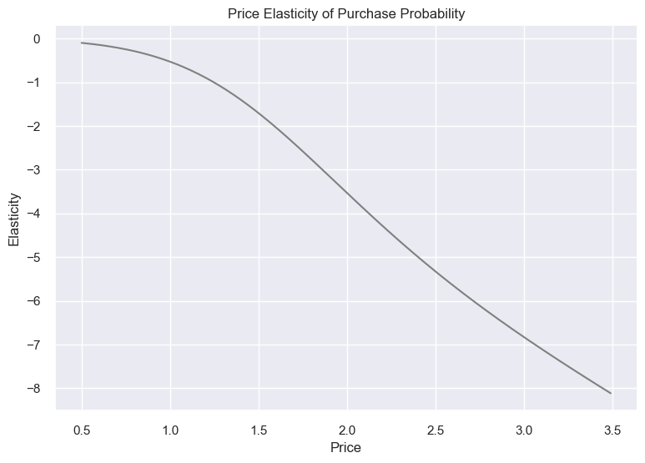
Now we plot the price elasticity of purchase probability of the average customer.
We observe that the price elasticities are all negative, i.e. the price elasticity decreases as price increases.
The decrease in price is slow in the range between 0.5 and 1.1, and then it became steeper after the 1.1 mark.
Thus, indicating the inverse proportionality between price and purchase probability.
So here we conclude that with prices lower than 1.25, we can increase our product price without losing too much in terms of purchase probability. For prices higher than 1.25, we have more to gain by reducing our prices.

Slide 25
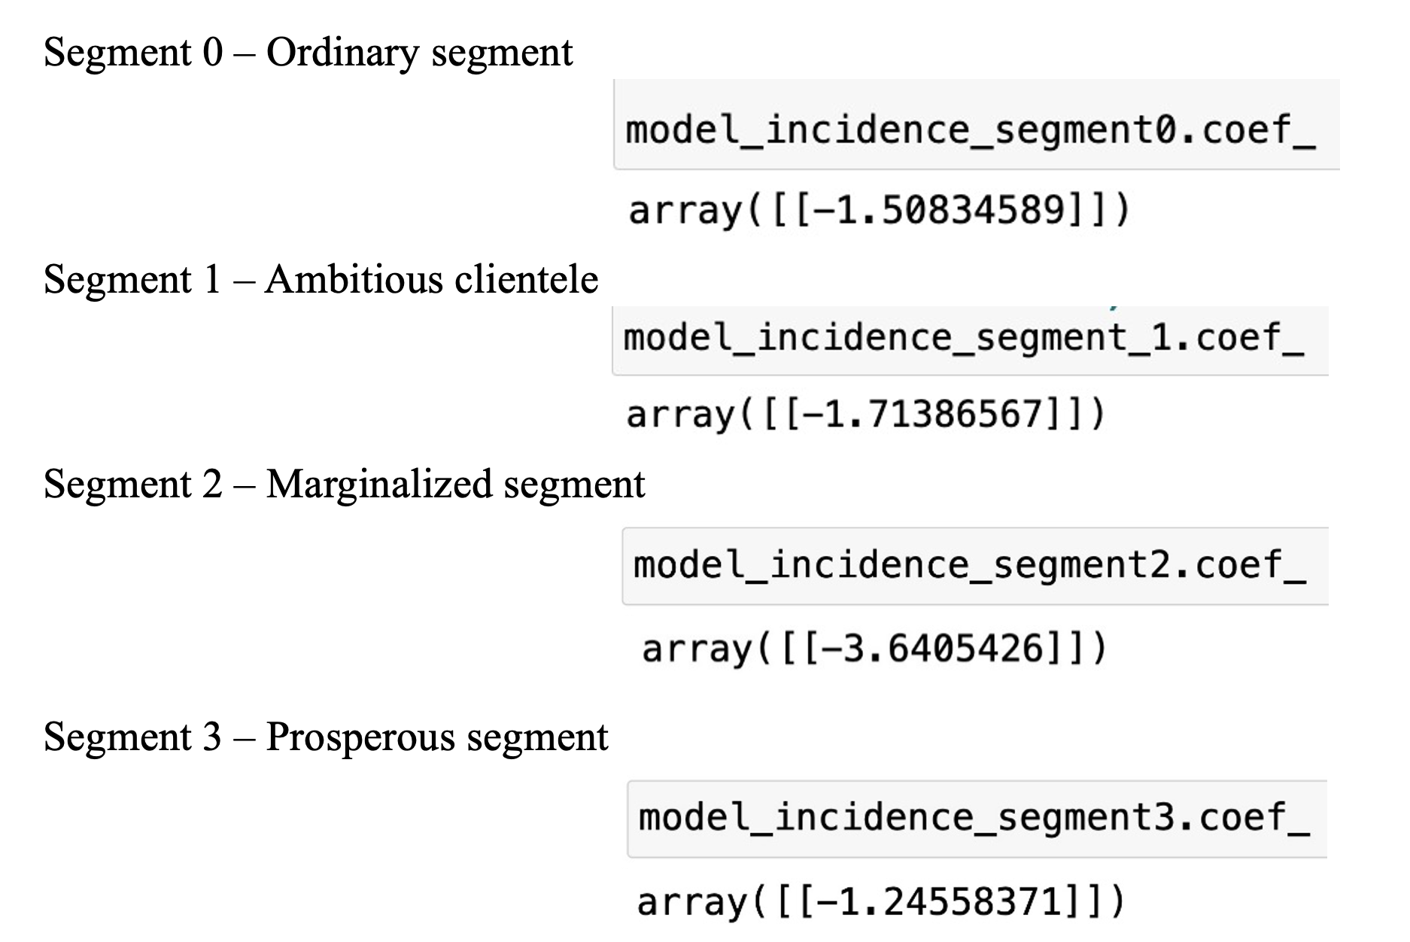
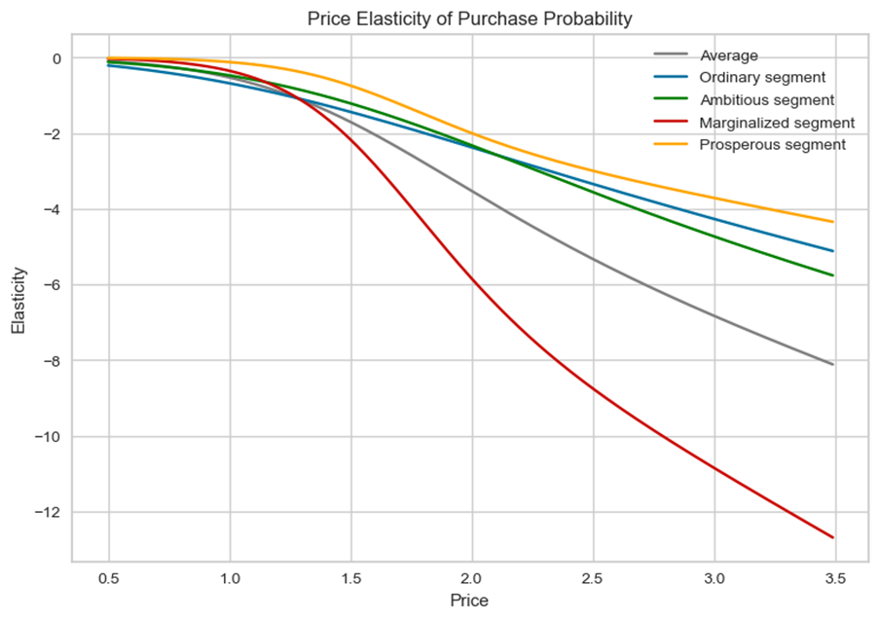
Purchase Probability by Segments
Ordinary segment: Raising prices within 0.5 to 1.24 range, especially as customers in the ordinary segment are highly price-sensitive. So, until prices point 1.24, purchase probability is inelastic.
Marginalized segment: We’d increase prices if we were in the 0.5 to 1.39 range, so, until prices point 1.39, purchase probability is inelastic.
Ambitious segment: We’d increase prices if we were in the 0.5 to 1.27 range and think about decreasing them afterwards. So, until prices point 1.27, purchase probability is inelastic.
Prosperous segment: increase prices if we were in the 0.5 to 1.62 range and decrease it afterwards. Customers in the prosperous segment are the least price-sensitive, so, until prices point 1.62, purchase probability is inelastic

Slide 26
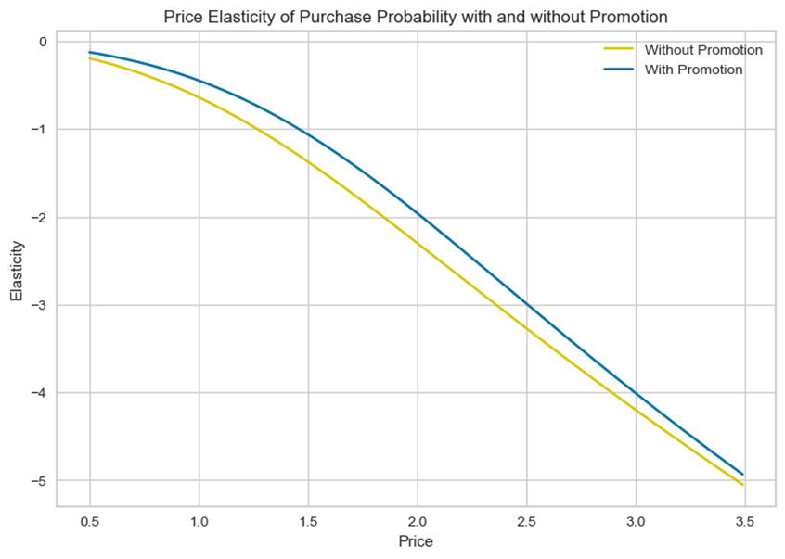
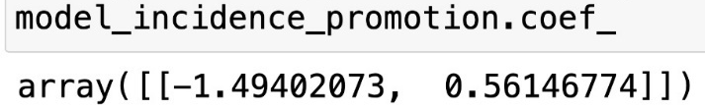
Purchase Probability With and Without Promotion Feature
Introduction of a promotion feature to account for its effect on purchase probability.
For model estimation we use Logistic Regression. The model quantifies the exact relationship between price, promotion, and probability of purchase. The resulting coefficients are -1.49 for price and 0.56 for promotion.
The coefficient for promotion is positive. Therefore, there is a positive relationship between promotion and purchase probability, meaning that with increase in promotion, the purchase probability also increases.
Now we calculate elasticity of purchase probability with and without promotion.
This graph tells us that elasticity curve with promotion sits above its respective no promotion counterpart for the entire price range. Customers are less price sensitive to price changes when there are promotion activities. According to this model, it would be more beneficial to have a higher original price and constant promotion rather than a lower original price.

Slide 27

References
https://data.world/sheakher/customer-activity-analysis
https://www.analyticsvidhya.com/blog/2019/05/beginners-guide-hierarchical-clustering/
https://www.analyticsvidhya.com/blog/2019/08/comprehensive-guide-k-means-clustering/#:~:text=The%20k%2Dmeans%20algorithm%20uses,the%20different%20properties%20of%20clusters.
https://www.analyticsvidhya.com/blog/2022/07/principal-component-analysis-beginner-friendly/
https://www.geeksforgeeks.org/what-is-exploratory-data-analysis/
Elasticity vs. Inelasticity of Demand: What's the Difference? (investopedia.com)
https://en.wikipedia.org/wiki/Price_elasticity_of_demand
https://scikit-learn.org/stable/modules/generated/sklearn.linear_model.LogisticRegression.html
https://www.techtarget.com/searchcustomerexperience/definition/customer-segmentation
https://www.khanacademy.org/economics-finance-domain/microeconomics/elasticity-tutorial/price-elasticity-tutorial/a/price-elasticity-of-demand-and-price-elasticity-of-supply-cnx
https://corporatefinanceinstitute.com/resources/economics/cross-price-elasticity/

Slide 28


